Slide 1
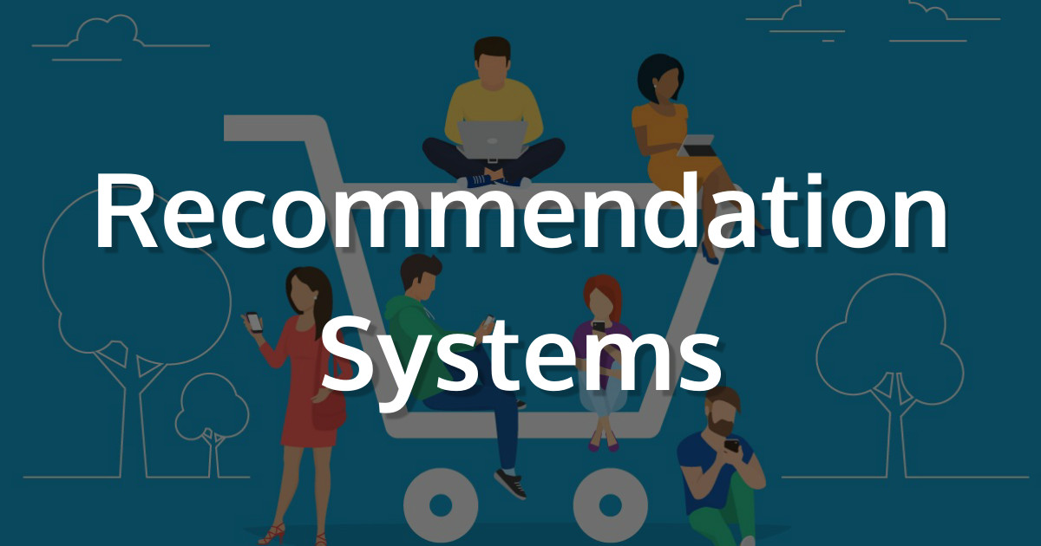
By
D.Asritha

Slide 2

What Is Recommendation system ?
A recommendation system (sometimes replacing "system" with a synonym such as platform or engine) is a subclass of information filtering system that seeks to predict the "rating" or "preference" a user would give to an item

Slide 3
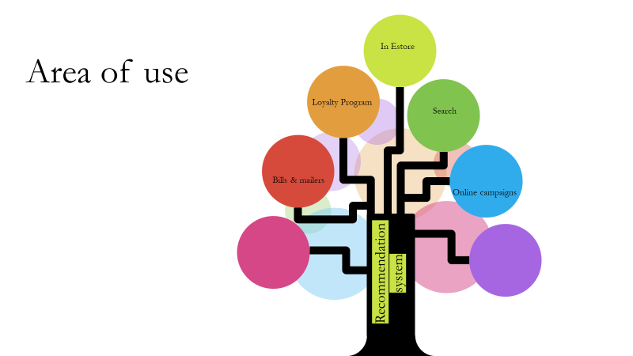

Slide 4
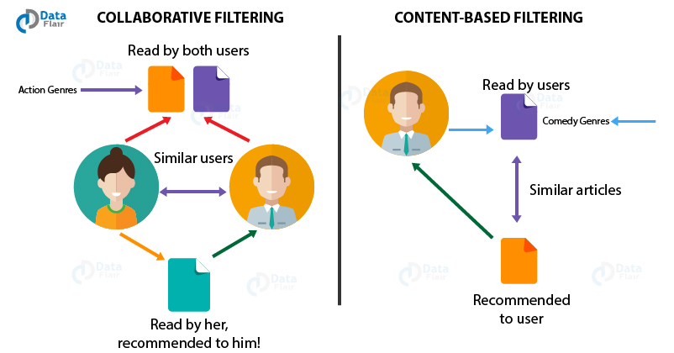
Types of recommendation system
They are 2 types of recommendation systems
Collaborative filtering :doesn’t need anything else except users’ historical preference on a set of items.
Content based filtering : approach requires a good amount of information of items’ own features, rather than using users’ interactions and feedbacks

Slide 5

Collaborative Filtering

Slide 6
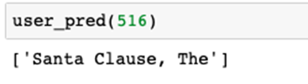
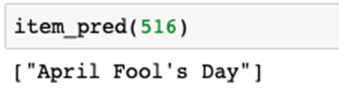
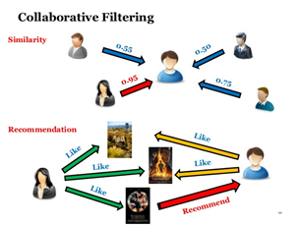
Collaborative Filtering
Item Based: the similarities between different items in the dataset are calculated by using one of a number of similarity measures
User Based: UB-CF uses that logic and recommends items by finding similar users to the active user
This is done by using similarity measures.

Slide 7
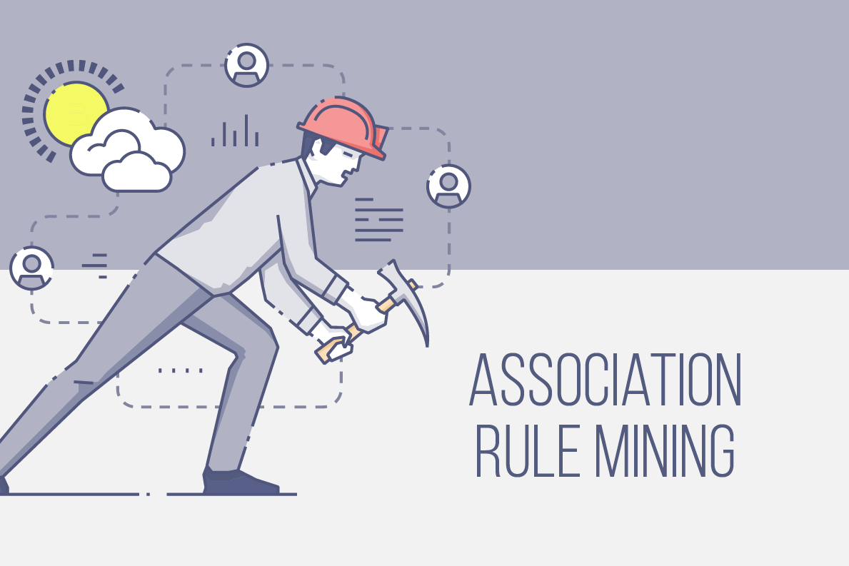

Slide 8

Market Basket analysis
Market basket analysis (MBA) is an example of an analytics technique employed by retailers to understand customer purchase behaviors

Slide 9
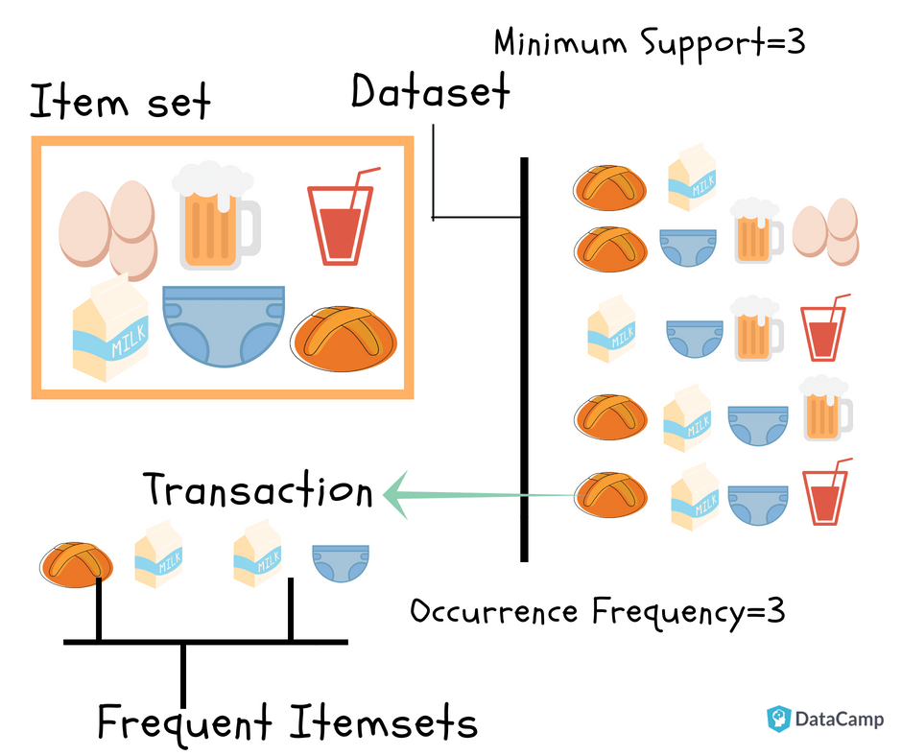
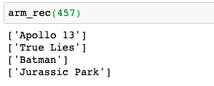
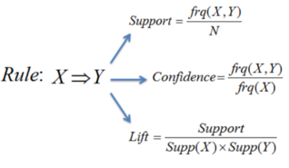
We calculate support for the item sets in data
From this we find the frequent item sets.
For the frequent item sets we findlift and confidence .
By using this we find the association rules.
From these rules we make the recommendations.
Above are the recommendations of movies

Slide 10

Recommendation system using genre based clustering

Slide 11
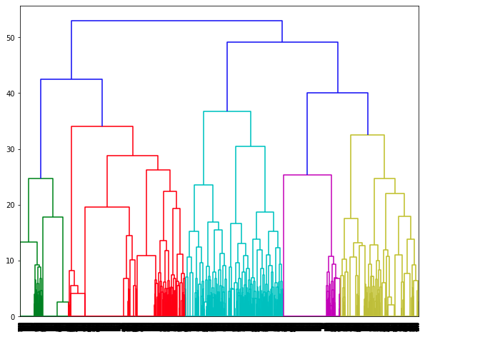
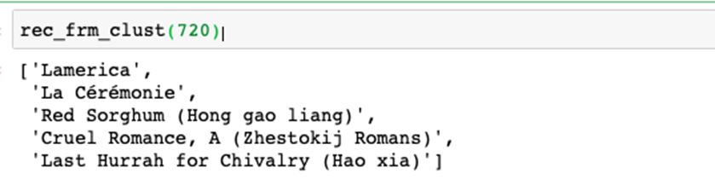
We cluster the movies into 6 clusters based on the similarities between the genres.
The clustering is done using the dendogram behind.
From the cluster we recommend user movie based on the movie they recently watched.
We recommend top rated movies which belong to the time period of the recently watched movie.
The given are the recommendations for a move user watched recently.

Slide 12


